Slide 1

Capstone Presentation
SQL Injection attacks detection and prevention
-By Mubasher Mehnaz Begum

Slide 2

Problem
Cyber Crime
Data Breaches
Flawed Access Control
DDos

Slide 3
Top 5: OWASP Survey
SQL Injection Attacks
Broken Authentication
Sensitive Data Exposure
XML External Entities (XEE)
Broken Access Control

Slide 4
SQL Injection
Most popular method used by hackers
Targets the database
Exploits a database query code to gain unauthorized data/access.
Bypass the Login Authentication
Failure to validate the reliability of user input data

Slide 5
Project Benefits
Provides mitigation techniques
Aims at identifying different kinds of attacks
Comprehension of how to perceive and guard against SQL Injection Attacks
Comparison of Safe code vs un-safe code
Various Prevention mechanisms and Tools available needed for automated detection

Slide 6
Project Implementation Approach
Detection
Identification
Prevention

Slide 7
Key concepts
Union-Based SQL Injection
select username, lastname from users where username = '1' union select address, phone from user_info
Blind SQL Injection
SQL Injection Using Booleans
select * from users where urole = 'admin' OR 2=2;
SQL Injection Based on Errors
SQL Injection Based on Time

Slide 8
Project Design
Frontend User Interface App
Java Springboot Rest API
MYSQL Database
Node JS, Node package Manager
React, JavaScript, HTML5, CSS3
Spring boot, Hibernate, JDBC, MySQL driver, Maven.

Slide 9
Project learnings
Practice and uphold
Practice and uphold awareness.
Trust
Never trust any data entered by a user; always carefully verify it.
Be
Input validation needs to be mandatory on both the client side and the server side.
Use
Always use the most recent technology and use newer versions of software.
Use
Use validated techniques, such as parameterized queries or stored procedures.
Conduct
Conduct regular web application scans using penetrating testing tools.
Compose
Compose code utilizing object-oriented programming strategies.
Stick
Stick to language-explicit conventions for code and approach.
Deal
Deal with SQL queries and data base connection errors in a profoundly solid way.

Slide 10
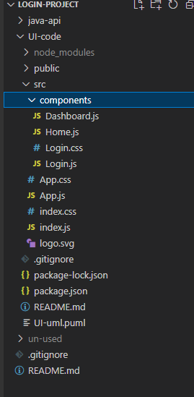
Frontend Integration
Frontend React App | Module | Function/Method
Start up files | Start up packages information required for dependencies | Package.json, Package-lock.json
Dependencies | All dependencies included in this folder | Node_modules/Gets installed on npm install
Application Root files | Main application module that builds the react application | Src/App.js/App()
Dashboard Component | Load the dashboard page | /src/components/dashboard.jsDashboard() handleLogout()
Home Component | Sample component | /src/components/dashboard.jsHome()
Login Component | Login Component which has call to REST API to Authenticate users | /src/components/login.js handleLogin()

Slide 11
JAVA Rest API Integration
Java Spring boot REST API | Module | Function/Method
Start up | Main Application class/method | com.capstone.restapi. Application com.capstone.restapi. Application.main()
Rest Controller | Authenticate User: Un-Safe code to show SQL Attack | com.capstone.restapi.controller. authenticateUnsafeUser()
Rest Controller | Get Users: Unsafe code to show SQL attack | com.capstone.restapi.controller. getUsers()
Rest Controller | Authenticate User: SAFE SQL method for preventing SQL Attacks | com.capstone.restapi.controller.authenticateSafeUser()
Rest Controller | Get Users: Safe code to show SQL attack | com.capstone.restapi.controller.getSafeUsers()
Rest Controller | Authenticate User: SAFE SQL method for preventing SQL Attacks – using JPA Repository approach | com.capstone.restapi.controller.authenticateUser()
Rest Controller | Method to establish JDBC connection | com.capstone.restapi.controller.getConn()
Exception Handler | Throw Resource not found exception | com.capstone.restapi.exception.ResourceNotFoundException()
Model with Entity mapping to DB. table | Model with getter/setters for Entity | com.capstone.restapi.model.User
Repository Interface | User Repository extending JPA Repository, ORM for Safe execution | com.capstone.restapi.repository. loggedInUser()om.capstone.restapi.repository. getUserById()
Service Interface & Implementation | UserServiceImpl for UserService for showing SQL Attack. | com.capstone.restapi.Service.authenticateUser()com.capstone.restapi.Service.getUserById()
Application properties | Contains jdbc connection string and other properties | /resources/application.properties

Slide 12
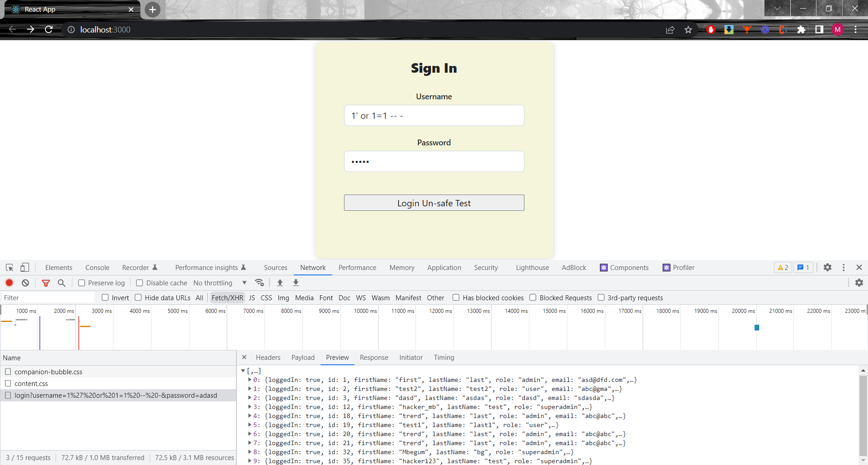
GUI Login User – Show Attack Scenario
Attack successful
Database is exposed

Slide 13
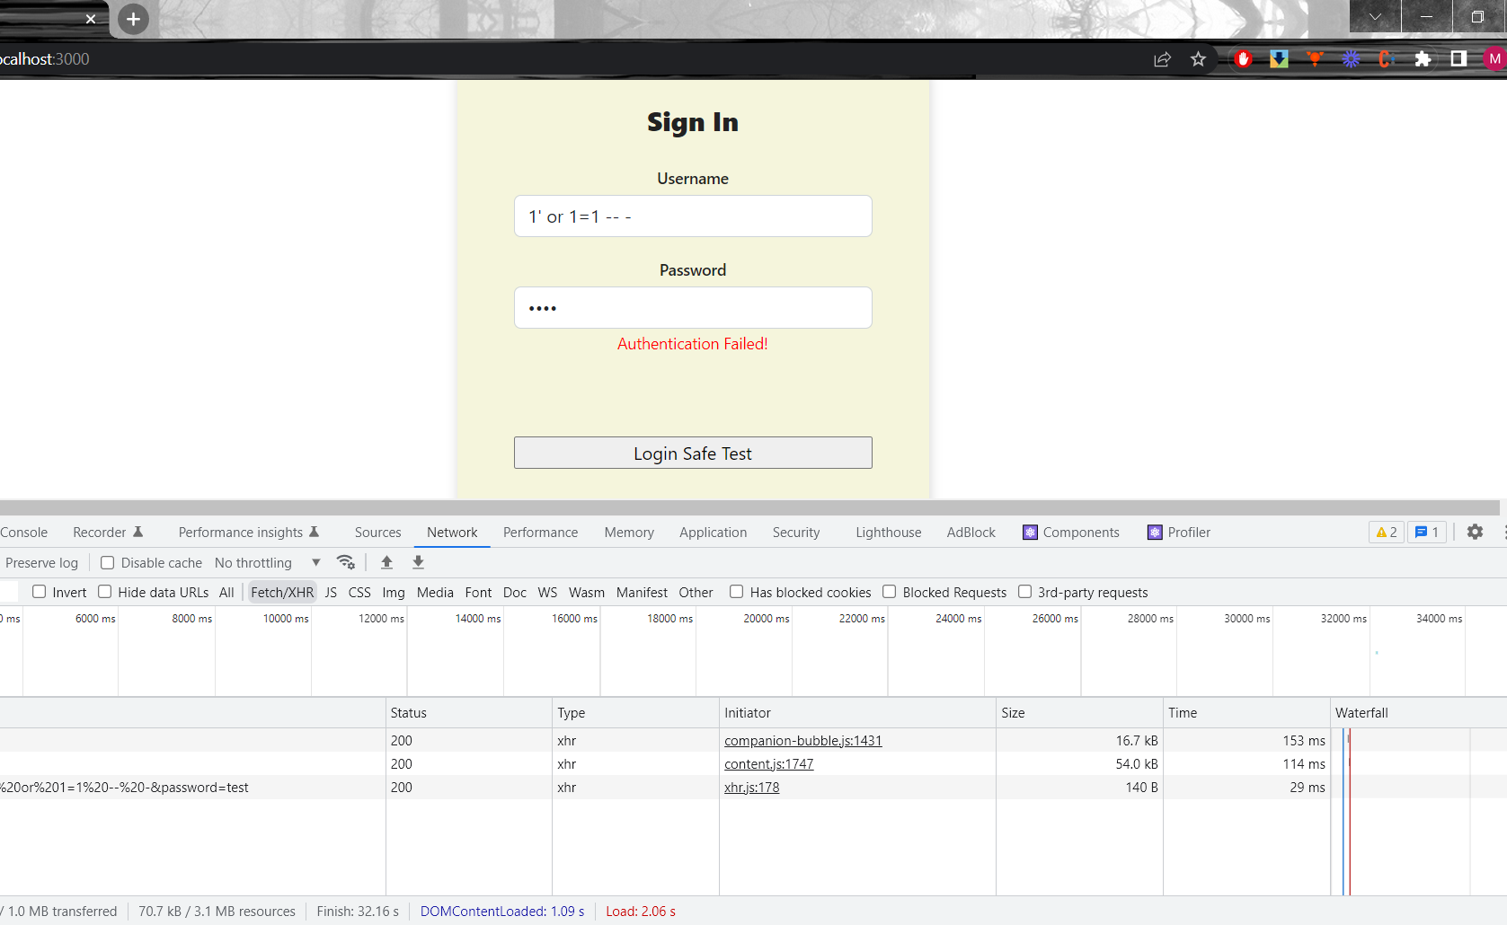
GUI Login User – Prevent Attack Scenario

Slide 14

Thank You

